Slide 1
2022 Choosing Wisely STARS Intro Meeting
Friday, January 14th, 2022
3:00 PM – 4:00 PM

Slide 2
Overview
Local and National Introductions
Our Purpose
Our Mentorship Philosophy
Expectations
Project Ideas
Social Media
Resources
Principles for Success
Logistics and Next Steps
Trade Secret, Confidential, Proprietary, Do Not Copy | OSU Wexner Medical Center © 2020

Slide 3
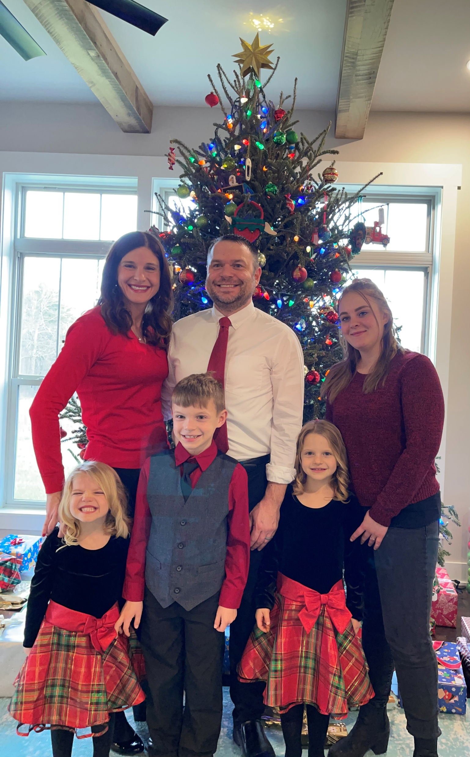
Local Introductions – Dr. Allison Heacock
Faculty Advisor
Internal Medicine/Pediatrics Hospitalist
Medical Director for Quality Improvement/Patient safety
HVC included in this role
SBP Competency Director
IM APD QI/PS
PSU Undergrad/OSU Med school
Sports Fanatic, Novice Gardener
Twitter: @allison_heacock
My Family is my Everything:
Me, Joe (Husband), Shaiane (Au Pair),
Lilyanne (4), Gavin (8), Skylar (6)
Trade Secret, Confidential, Proprietary, Do Not Copy | OSU Wexner Medical Center © 2020

Slide 4
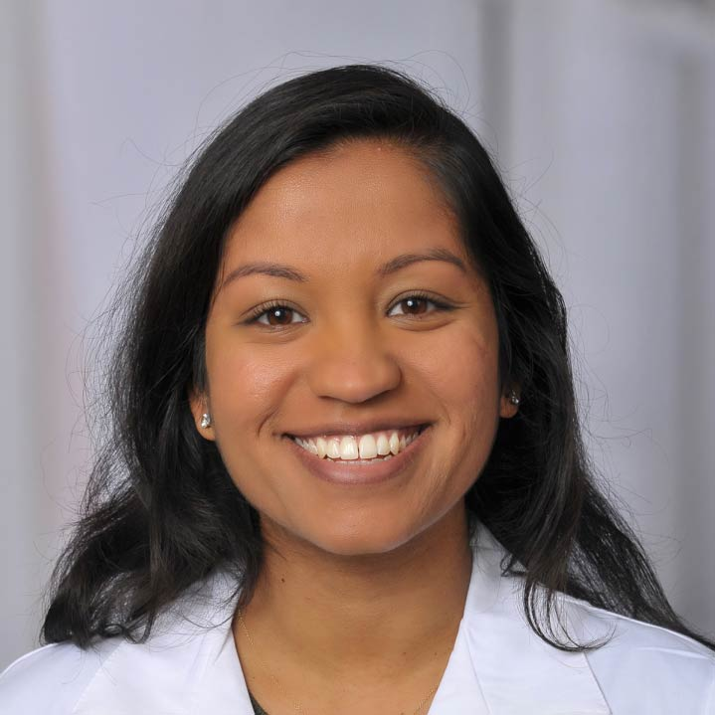
Local Introductions – Dr. Neethu Abraham Faculty Advisor
IM-trained hospitalist
Medical School: University of Pittsburgh College of Medicine
Residency: University of Pittsburgh Medical Center
Interests in quality improvement and high-value care within systems
Former (current?...) expert unicyclist
Trade Secret, Confidential, Proprietary, Do Not Copy | OSU Wexner Medical Center © 2020

Slide 5
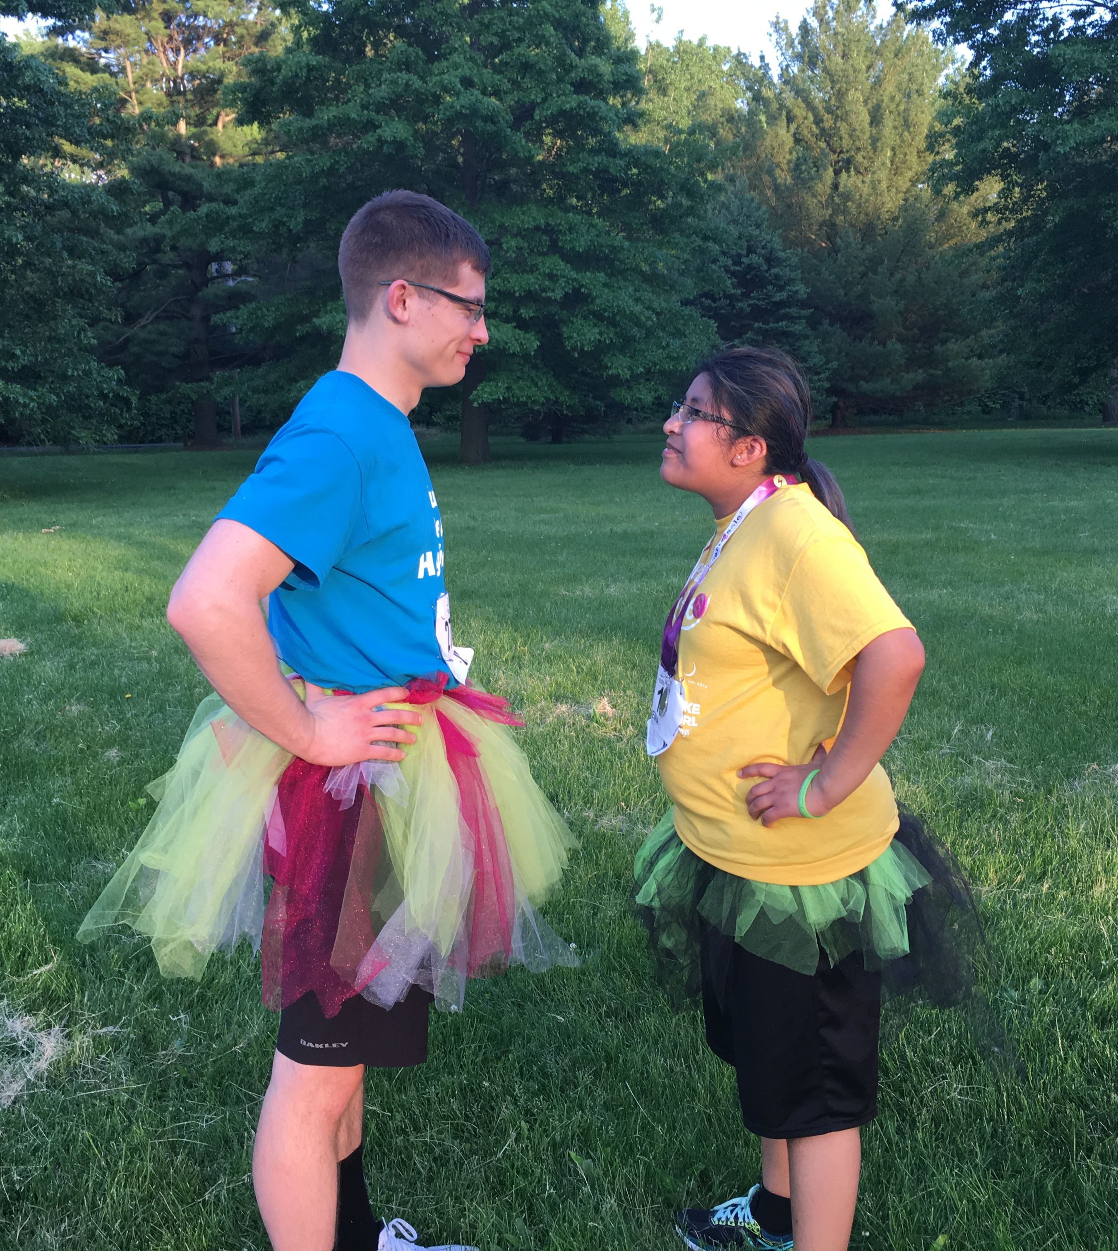
Local Introductions – Ben Dralle
Third-year medical student in the MD program
2020 Choosing Wisely STARS Representative
Social Media Manager at Costs of Care
Career interests: psych, IM, hem/onc, health care affordability, med ed, and mentorship
Twitter: @ben_dralle
Trade Secret, Confidential, Proprietary, Do Not Copy | OSU Wexner Medical Center © 2020

Slide 6
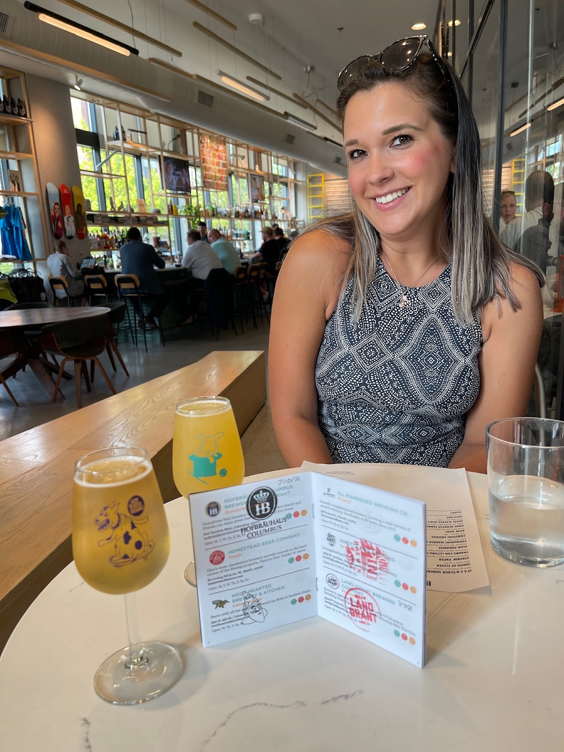
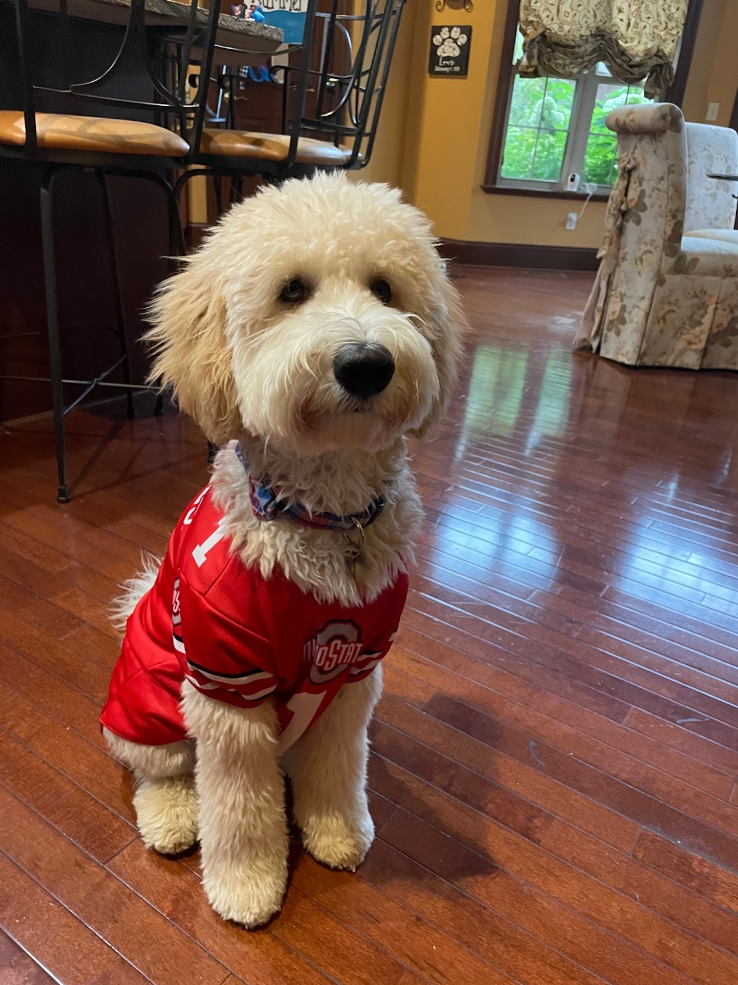
Alexia Markowski
From Akron, OH
Medical student at tOSUCOM
Most interested in Emergency Medicine
Hobbies : Columbus Ale Trail and looking at pics of my dog Louis (see attached)
Fun fact : I’ve been on 12 Disney Cruises
Twitter: @alexiamarkowski
Trade Secret, Confidential, Proprietary, Do Not Copy | OSU Wexner Medical Center © 2020

Slide 7
Local Introductions – Avani Kabra
M2!
2021 STARS student → 2022 peer mentor
Career interests: a surgical specialty (maybe?)
Other interests: patient experience & quality improvement
Hobbies: dance, ukulele, hiking
Trade Secret, Confidential, Proprietary, Do Not Copy | OSU Wexner Medical Center © 2020

Slide 8
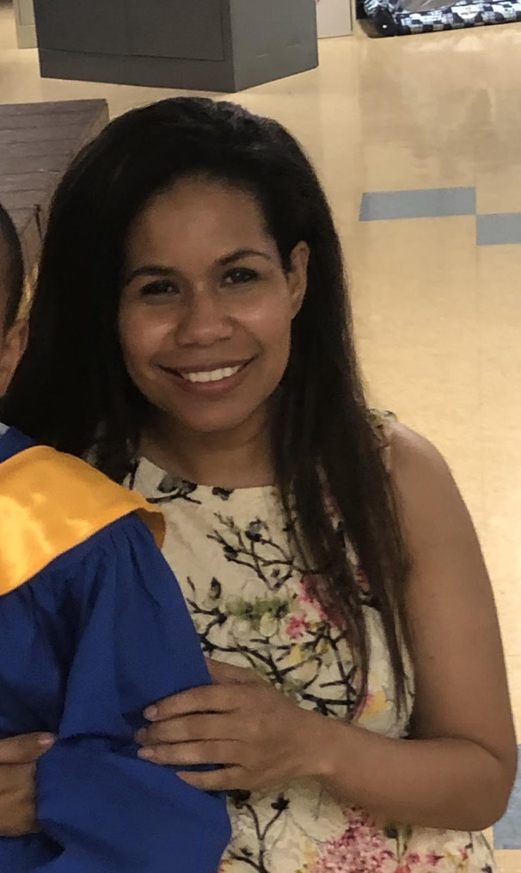
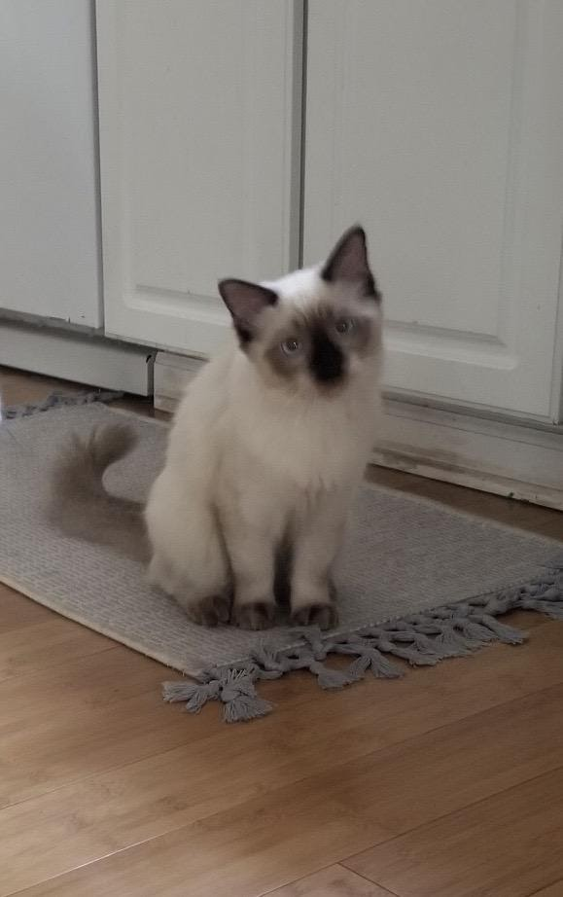
Local Introductions – Janine Bennett
MS2
Career interests: Urology, EM
Fun facts:
My cat, Riley →
I talk to my mother every day.
I’ve never traveled outside the U.S. but it’s on my bucket list.
Trade Secret, Confidential, Proprietary, Do Not Copy | OSU Wexner Medical Center © 2020

Slide 9
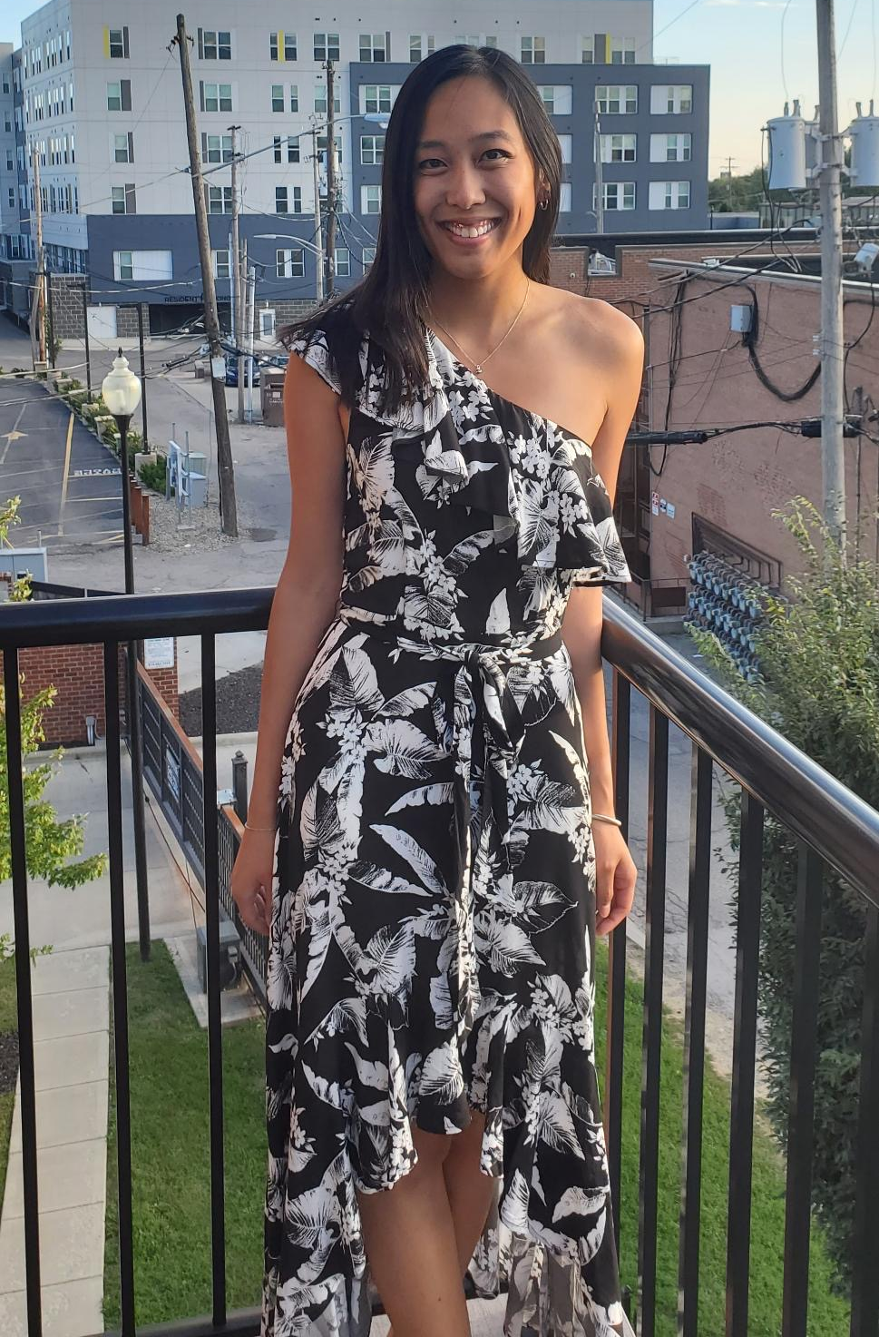
Local Introductions – Tiffany Guan
M2, 2021 STARS Cohort
Career interests: no particular field (yet), HVC, AANHPI health issues
Born, raised, and went to school in Boston, MA
Got interested in HVC during my 2 gap years working as a clinical assistant in a dermatology practice
PicIMG_6505.JPGture of your choice here!
Trade Secret, Confidential, Proprietary, Do Not Copy | OSU Wexner Medical Center © 2020

Slide 10
Local Introductions – 2022 STARS Cohort
Anitra Karthic | Mychael Dopirak
Lily Kreber | Hannah Shenton
Trade Secret, Confidential, Proprietary, Do Not Copy | OSU Wexner Medical Center © 2020

Slide 11
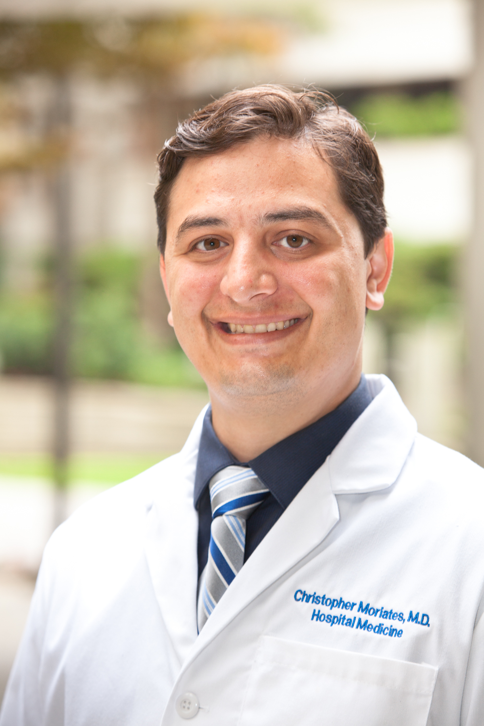
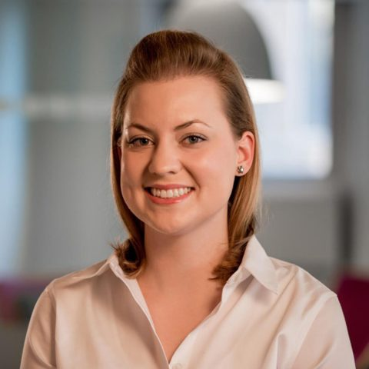
National Introductions
Chris Moriates, MD
Dell Medical School,
Choosing Wisely STARS, and
Costs of Care
September Wallingford, RN, MSN
Operations Director
at Costs of Care
Trade Secret, Confidential, Proprietary, Do Not Copy | OSU Wexner Medical Center © 2020

Slide 12
So… what are we doing here?

Slide 13
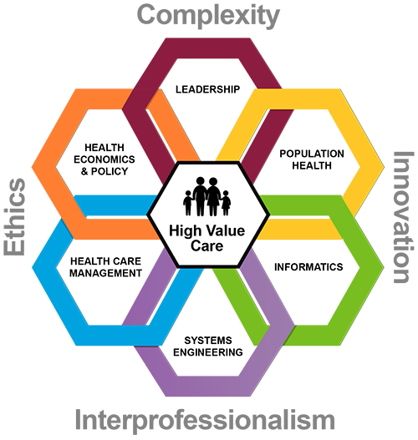
Our Purpose
Continue to build a culture of high-value care here at OSU
Use our positions as STARS and the mentorship of our faculty advisors and STARS program faculty to be change agents locally and nationally
Facilitate your career development in your areas of interest
Build a legacy of medical students, residents, fellows, and physicians who practice high-value, cost-conscious care
Trade Secret, Confidential, Proprietary, Do Not Copy | OSU Wexner Medical Center © 2020

Slide 14
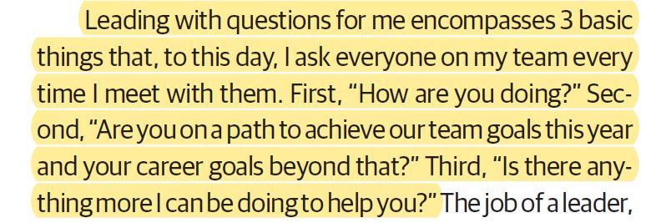
Our Mentorship Philosophy
Leading with Questions in JAMA Surgery
Trade Secret, Confidential, Proprietary, Do Not Copy | OSU Wexner Medical Center © 2020

Slide 15
Our Mentorship Philosophy – Cont.
Two other principles:
Decentralized
command
Prioritize and
execute
Trade Secret, Confidential, Proprietary, Do Not Copy | OSU Wexner Medical Center © 2020

Slide 16
Our Mentorship Philosophy – Cont.
High Expectations | High Support |  | Low Expectations
 | Low Support
STARS Program

Slide 17
Expectations
Prior to January 21st
View pre-recorded material created by Choosing Wisely STARS faculty members (~40 minutes of content)
Complete Course 1A (Modules 1-3) of the Discovering Value-Based Health Care online series (approx. 2.5 hours of total work) – register for free online
Complete STARS report outs – see PDF for instructions and email September
January Leadership Summit –focus on learning lessons from prior STARS students, project planning, and the intersection of health equity and value
Friday, January 21, 2022 from 7:00 PM – 8:30 PM EST
Saturday, January 22, 2022 from 1:00 PM – 4:00 PM EST
Trade Secret, Confidential, Proprietary, Do Not Copy | OSU Wexner Medical Center © 2020

Slide 18
Expectations – Cont.
Mid-Year Leadership Summit – attend an additional Zoom session focused on leadership skills, advocacy, and overcoming project barriers
Scheduled in May 2022 – more scheduling details later
Rough timeline for the year:
Meeting in early February for summit debrief and planning
Planning for monthly meetings with our OSU team throughout the year to provide feedback, check in about progress, support regular access to mentors, etc.
STARS Student Calls throughout the year
Two intersessions scheduled – usually virtual lectures
Carry out projects along the way!
Trade Secret, Confidential, Proprietary, Do Not Copy | OSU Wexner Medical Center © 2020

Slide 19
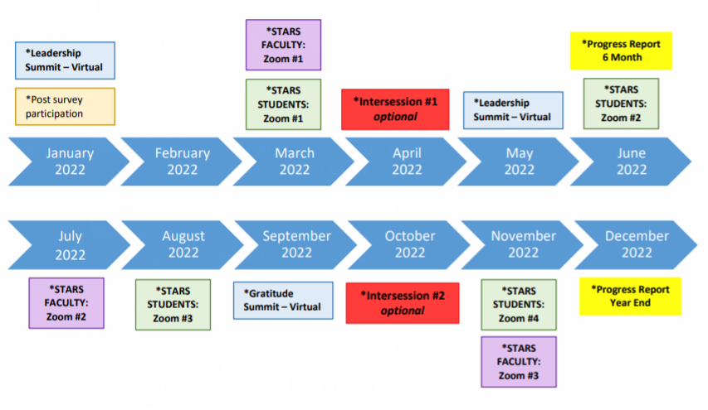
Expectations – Cont.
Trade Secret, Confidential, Proprietary, Do Not Copy | OSU Wexner Medical Center © 2020

Slide 20
Project Ideas – Ongoing Projects
Selective course for M1s and M2s (Alexia and Avani)
84 students enrolled over the past two years
Due for re-evaluation and improvement
Submit course proposal over the summer, teach course twice in the fall, evaluate afterwards, etc.
Presentation with Internal Medicine Interest Group
Tiffany finding a date for this – lead by 2021 cohort
Implementing HVC in LG curriculum (Janine)
Progress stalled amidst COVID, LCME accreditation
Picking this back up with cardio-pulm and endo-repro, will be a major focus for this next year
Trade Secret, Confidential, Proprietary, Do Not Copy | OSU Wexner Medical Center © 2020

Slide 21
Project Ideas – New Project Examples
Work with Prior librarians to develop a high-value care subject guide
Financial toxicity order set from MSKCC
Copay assistance, quality of life costs, etc.
Lectures with student groups – expectation that STARS will complete these this year (Tiffany)
Ex: Surgery Interest Group, Pediatrics Interest Group, etc.
Goal: create a “deliverable” for your CV
Ex: poster presentation or paper
OSU Annual Education Symposium, High Value Practice Academic Alliance Annual Meeting, etc.
Trade Secret, Confidential, Proprietary, Do Not Copy | OSU Wexner Medical Center © 2020

Slide 22
Project Ideas – Creating “Deliverables”
Trade Secret, Confidential, Proprietary, Do Not Copy | OSU Wexner Medical Center © 2020

Slide 23
Social Media
Social media, especially Twitter, is an excellent extension of this program – not required, but highly encouraged
Multiple benefits:
Expand your learning opportunities
Gain practice as an educator
Identify new opportunities
Promote OSU (and you!)
Resources:
A Beginner’s Guide to Joining Academic Twitter
7 ways Twitter can help you thrive in medical school
High-value care chat with @MedStudentChat
Trade Secret, Confidential, Proprietary, Do Not Copy | OSU Wexner Medical Center © 2020

Slide 24
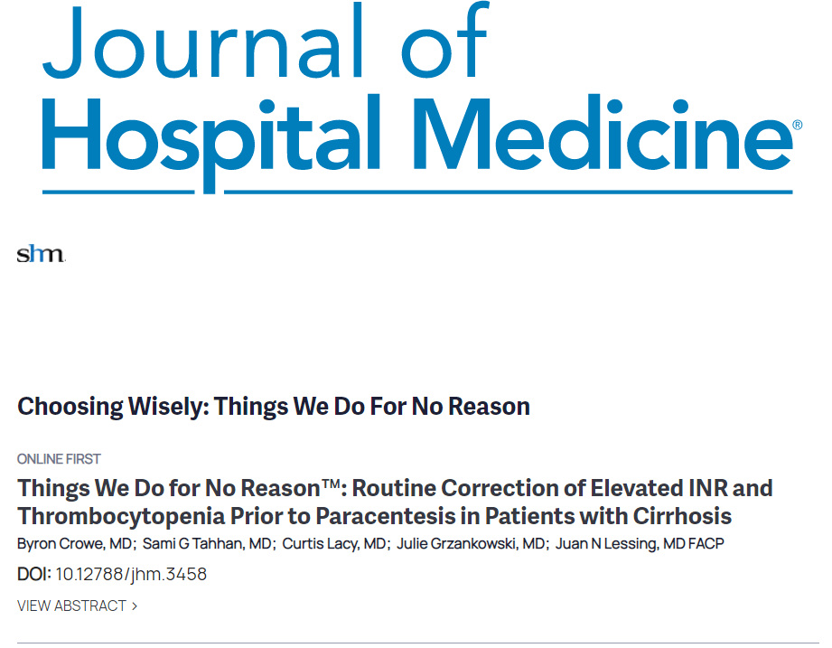
Resources
HVC resources slide shared via email
Several formats available:
Online modules – Dell Med modules, Costs of Care, Order Wisely
Article series – TWDFNR, Teachable Moment and Less is More in JAMA, GOTMeDS Framework for Drug Costs
Podcasts – Clerkship Wisely, Race to Value by ACLC
Emails – Surgery and Perioperative Care Value-Based Health Care Reading List, PubMed alerts, CHIR Surprise Medical Bills email newsletter

Slide 25
Principles for Success
You will get out of the program what you put into it.
Ask questions, ask questions, ask questions.
Concrete projects with concrete goals and concrete deadlines work the best.
Have fun along the way!

Slide 26
Logistics and Next Steps
Will be using a combination of email and Teams to communicate and stay organized
Email addresses:
Faculty Advisors | Dr. Allison Heacock | allison.heacock@osumc.edu
 | Dr. Neethu Abraham | neethu.abraham@osumc.edu
Peer Mentors | Ben Dralle | benjamin.dralle@osumc.edu
 | Alexia Markowski | alexia.markowski@osumc.edu
 | Avani Kabra | avani.kabra@osumc.edu
 | Janine Bennett | janine.bennett@osumc.edu
 | Tiffany Guan | tiffany.guan@osumc.edu

Slide 27
Logistics and Next Steps – Cont.
Complete intake form – sent via email
Complete summit pre-work and mark summit dates on your calendars
Look through additional resources as time allows
Clerkship Wisely: Introduction w/ Dr. Chris Moriates
Set up a Twitter account if you’d like – and let us know if you do!
Let us know if you have any questions
And…

