Slide 1
2021 STARS Summit Debrief + Project Planning
Friday, February 5th
1:00 PM – 2:00 PM

Slide 2
Congrats to Dr. Heacock!

Slide 3
Why are we here again?...
Published in JAMA - Building Health Care Better Means Reining in Costs

Slide 4
Happies and Crappies

Slide 5
Summit Debrief
What ideas/concepts/topics from the summit were new to you? What ones were you already familiar with?
Was there anything that surprised you during the summit? Anything you found confusing?
What ideas/concepts/topics did you learn about from your small group discussions?

Slide 6
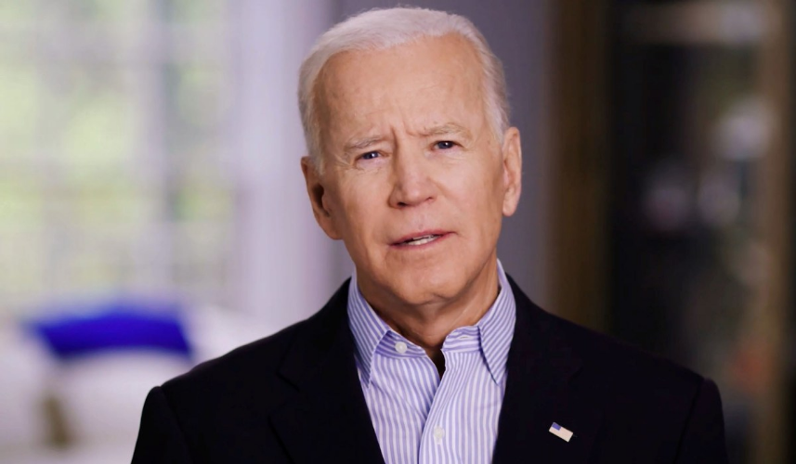
Project Planning
What’s Joe Biden’s your plan for implementing an awesome HVC education project?

Slide 7
Project Planning
What types of high-value care curriculum projects do you want to carry out over the next year?
Several small projects? One large project? A mix of both?
Should we split up into teams?
How can we avoid the diffusion of responsibility and maintain accountability?

Slide 8
Previously Discussed Ideas

Slide 9
SWOT Analysis (https://www.mindtools.com/pages/article/newTMC_05.htm)
Strengths | Weaknesses
Opportunities | Threats

Slide 10
Now that we have an idea…
What sorts of resources (time, people, etc.) will we need to get this done during this year?
How will we measure this to know if we were successful?
How can next year’s STARS build on or utilize this project?
What “deliverables” can we earn along the way?

Slide 11
Next Steps
For each project/component of our work:
Consider SWOT analysis (not required)
Logic model (required)
Gantt chart/timeline (required)
Why are we doing these?
Will help us get the projects done better – more efficient and on time
Accountability – we know what needs to be done
Your professional development

Slide 12
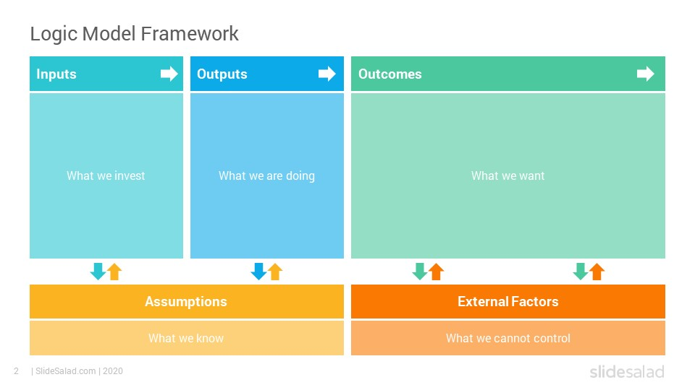
Logic Model – Sample

Slide 13
Logic Model – Our Requirements
Project/goal: What is the overarching project or goal?
Assumptions: What we know, what we’ve done before, etc.
Inputs: What we invest (people, time, resources, etc.)
Outputs: What are we going to be doing (teaching, presenting, etc.)
Outcomes: What we want, and how we’ll measure and present that
External factors: What other factors will impact our ability to complete these projects?

Slide 14
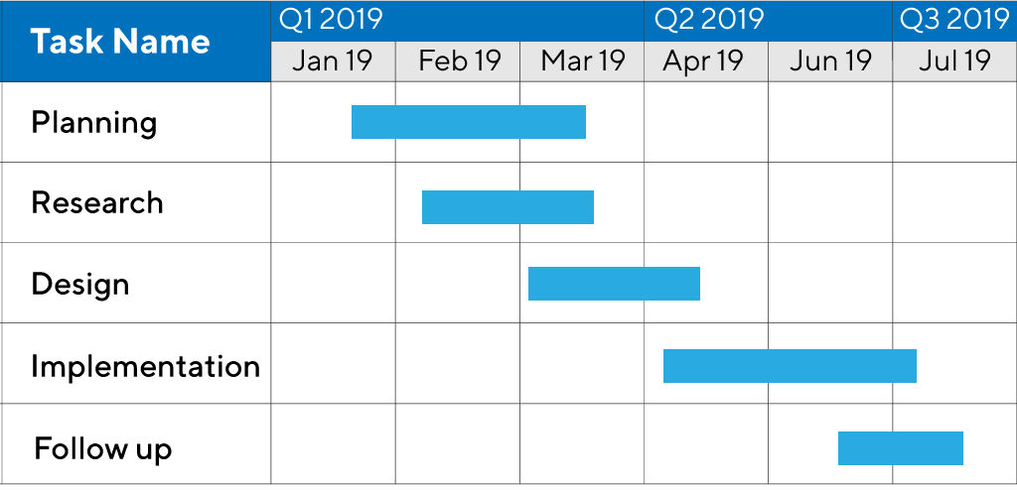
Gantt Chart – Sample

Slide 15
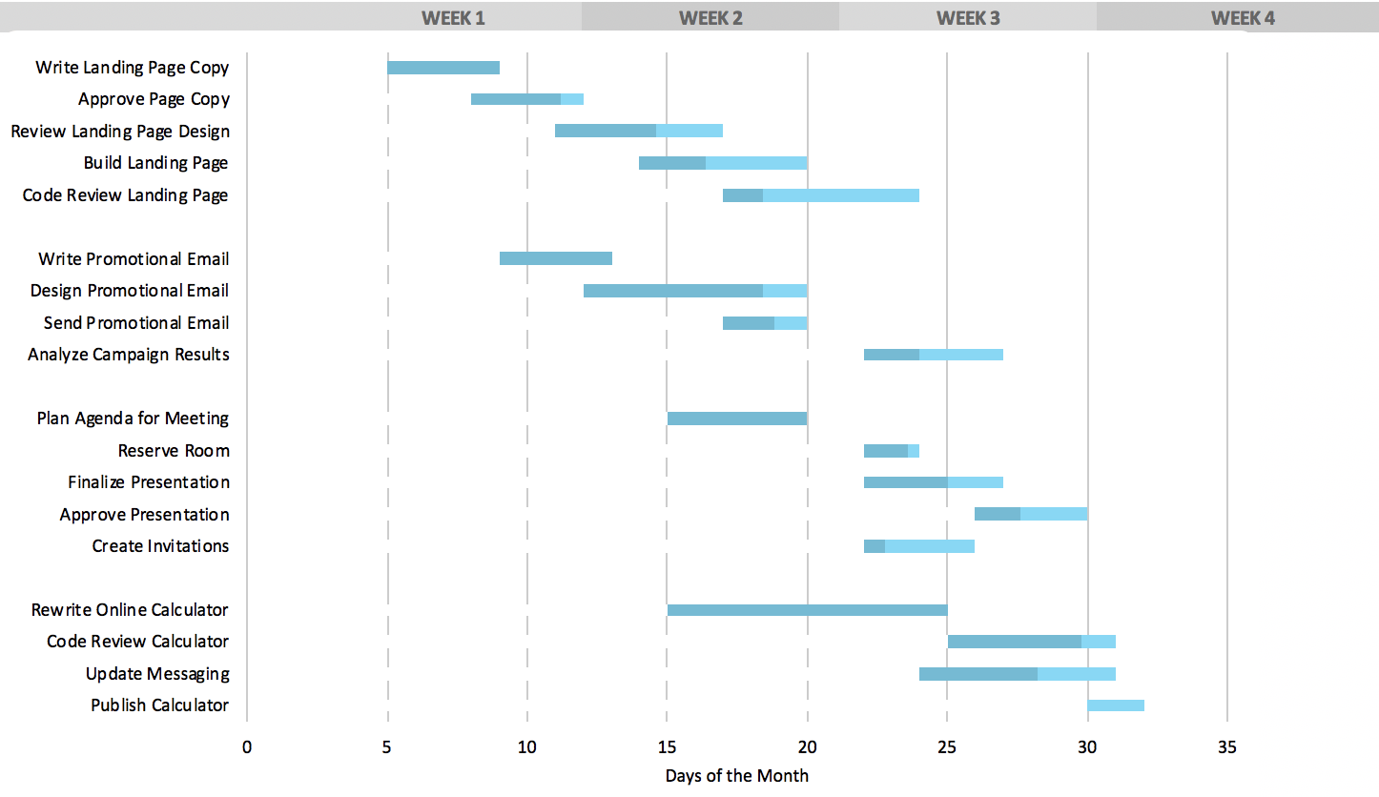
Gantt Chart – Our Requirements
Can use a Gantt chart maker (Google for instructions or to find free websites) or a simple Word/Excel doc
Break your logic model down into tasks – see example, but maybe be a bit more specific
Pick a time period for the x-axis – anywhere from one-week periods up until a month (not longer than a month)
Apply tasks to the specified time period… and recognize some inherent flexibility

Slide 16
Summary and To-Do List
For projects – as assigned:
SWOT analysis (optional)
Logic model (required)
Gantt chart/timeline (required)
Due date is TBD – will be based on mentorship team’s availability and your cardio-pulm final exam date
Individually:
One presentation to student group – Surgery Interest Group, Pediatrics Interest Group, etc.
Think about this – work with your network/interests to facilitate it

Slide 17
Upcoming Event
STARS Intersession – Thursday, March 4th at 8:00 PM EST
Dr. Andrew Parsons – Assistant Professor of Medicine and Public Health at the University of Virginia School of Medicine
Topic: Cognitive Error and Value: How Our Biases Impact Clinical Decision-Making
Review two articles beforehand:
https://pubmed.ncbi.nlm.nih.gov/28490292/
https://pubmed.ncbi.nlm.nih.gov/30508015/
Register at the Zoom link that September sent out

Slide 18
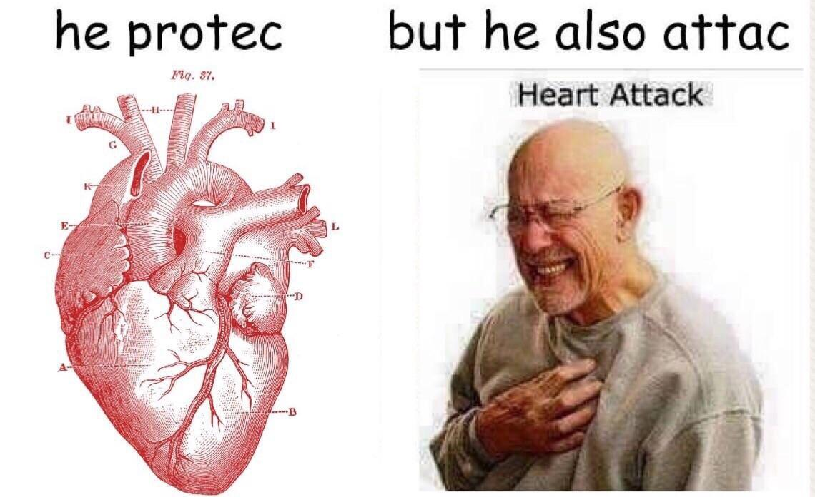
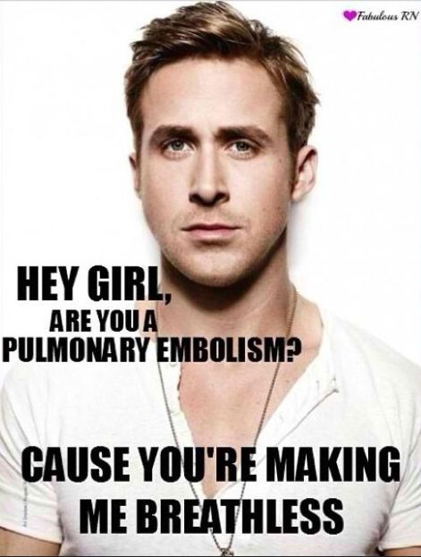
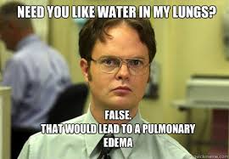
Questions?

